Slide 1
EMBEDDED SYSTEMS: COMMUNICATION PROTOCALS
BY: Kennedy odeyo otieno
EEE LEVEL 500
05/07/2024

Slide 2
NEED?
Communication Protocols define rules for data exchange between devices
They ensure reliable and synchronized communication in embedded systems
We will focus on three widely used Protocols:
I2C
UART
SPI

Slide 3
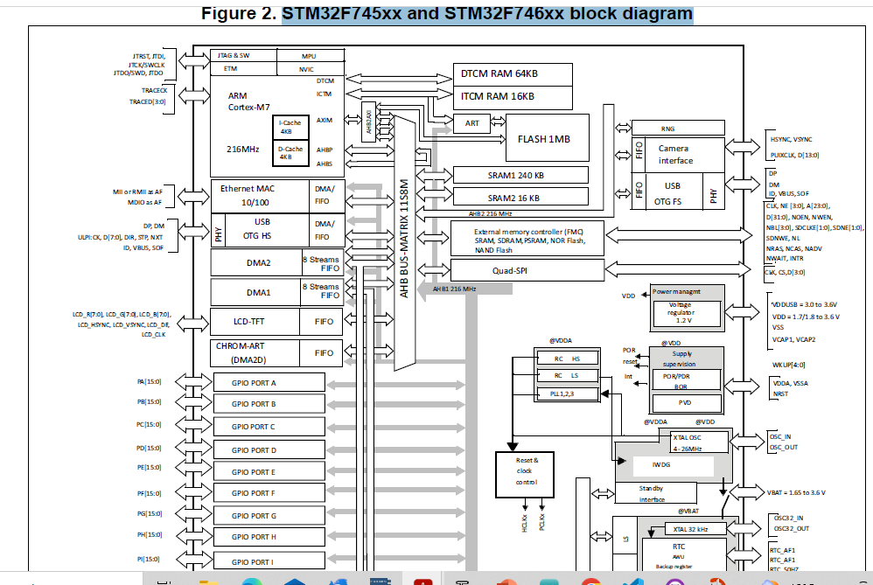

Slide 4
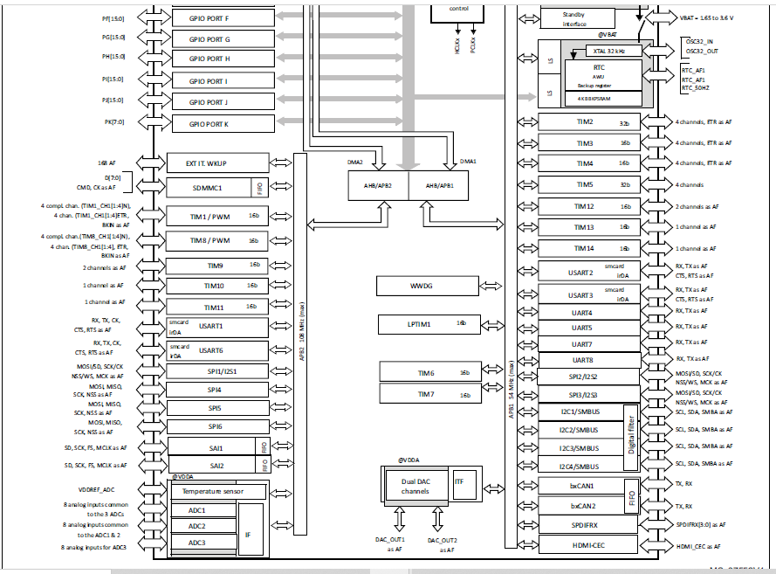

Slide 5
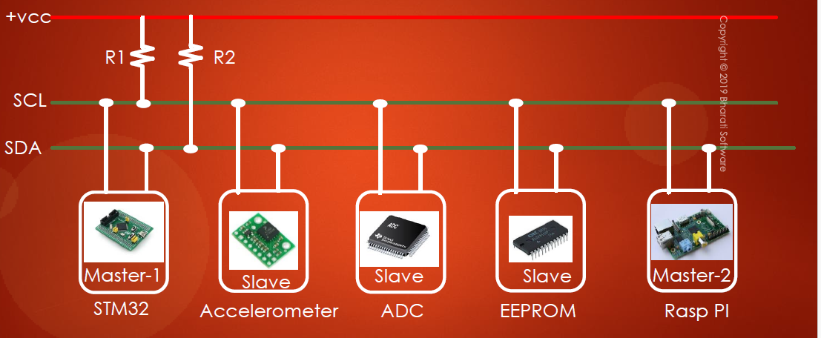
Inter-integrated Circuit (I2C)
It is a 2 wire interface having Serial Data Line (SDA) and Serial Clock Line(SCL)
The addressing modes are 7-bit or 10 bit addressing modes. The most common used one is 7-bit addressing mode
Here the master initiates communication and the slave responds.
I2C is multi master capable i.e. many masters and slaves on only two lines.

Slide 6
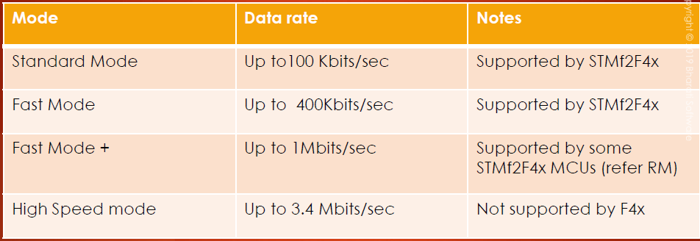
I2C master talks to slaves based on slave addresses.
The communication is half duplex.
There are various I2C modes as shown below.
Commonly used mode is Standard mode. Most of these modes are downward compatible

Slide 7
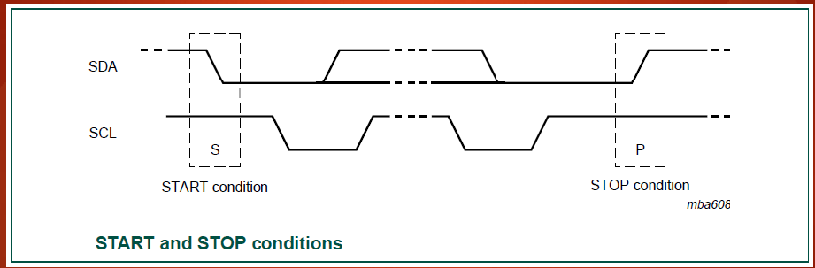
How it works
All transactions begin with Start Condition and end with a STOP condition. A HIGH to LOW transition on the SDA line while the SCL is HIGH defines a START condition while a LOW to HIGH transition on the SDA line while SCL is HIGH defines a STOP condition as shown below.

Slide 8
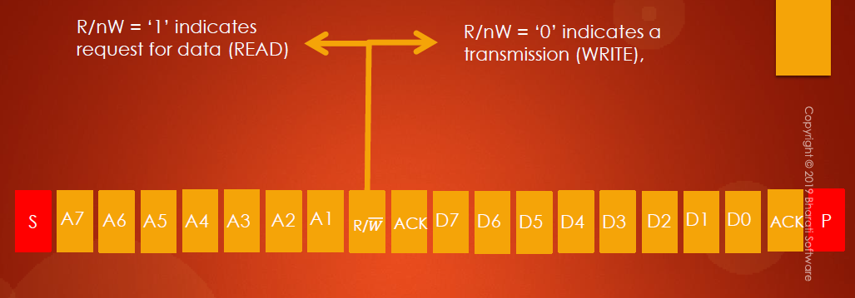
Every byte put on the SDA line must be 8 bits long
Each Byte must be followed by an Acknowledge Bit
Rember, Data is transferred with the Most Significant (MSB ) first

Slide 9
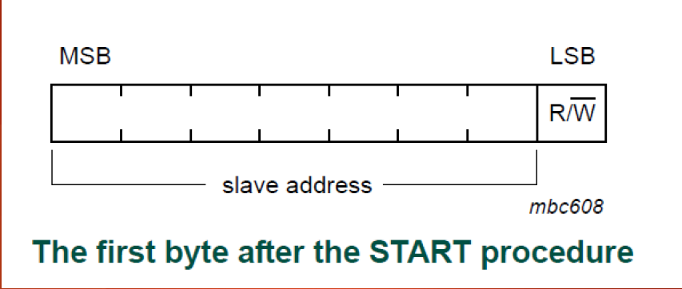

Slide 10
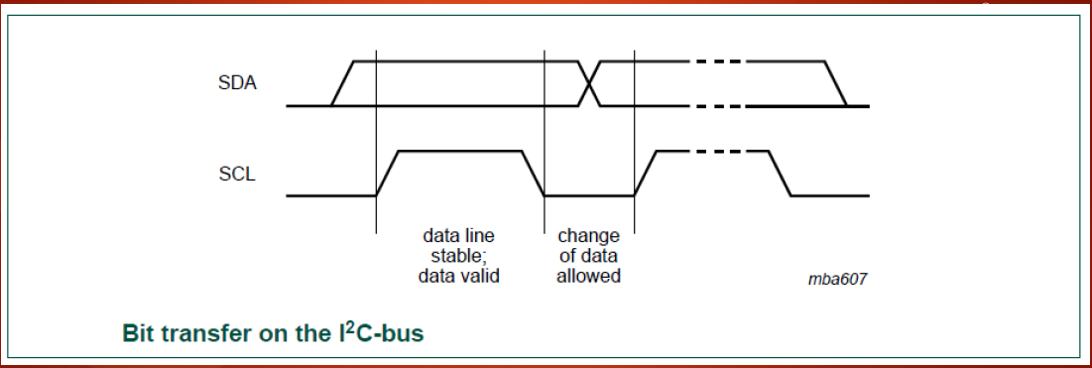
Remember that the START and STOP conditions are initiated by the master. The bus is busy after the START condition and becomes free after the STOP condition.
Data is valid only when it is stable on the SDA line during a HIGH period of the Clock. Change of data is allowed during the LOW period of the clock.

Slide 11
Advantages of I2C
It is a simple 2 wire interface
It supports multiple devices on the same bus
Acknowledgement mechanism ensure data integrity
Disadvantages of I2C
Limited speed compared to other protocols
Bus Capacitance limits maximum bus length
Complexity in software handling for multiple devices

Slide 12
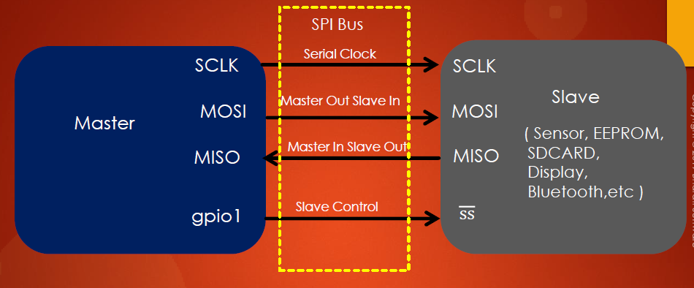
Serial PERIPHERAL INTERFACE
It is a 4 wire communication protocol and the SPI bus allows communication between one master device and one or more slave devices.

Slide 13
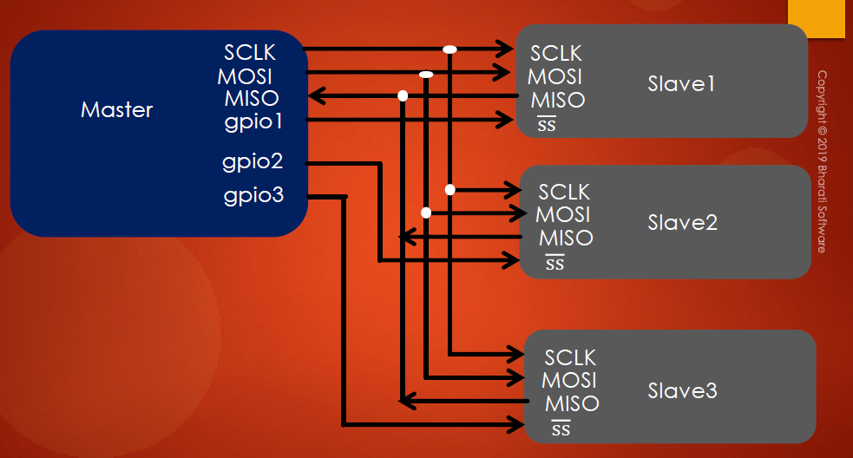

Slide 14
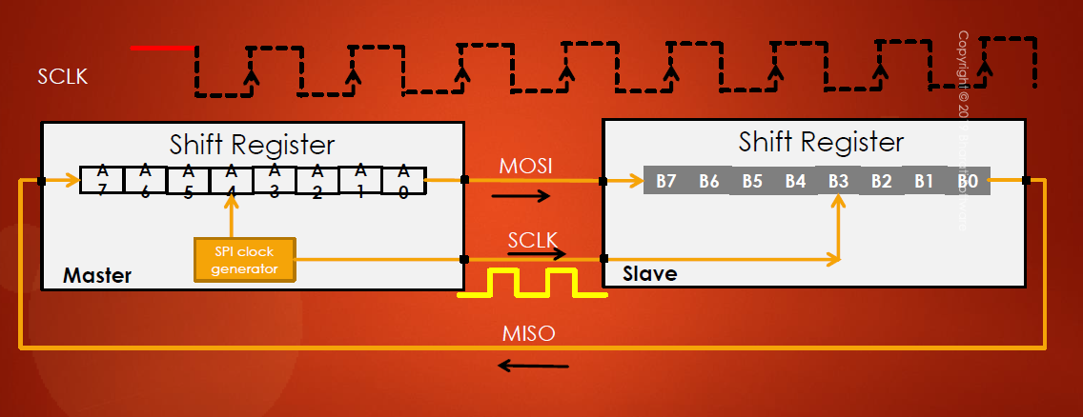
How it works

Slide 15
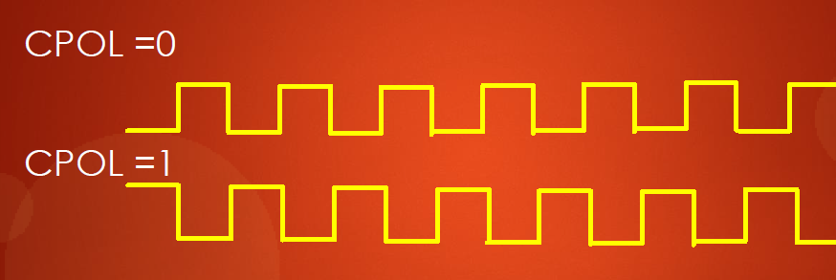
SPI allows the following types of bus configuration
Full Duplex Communication
Half Duplex Communication
Simplex Communication
CPOL(Clock Polarity)
This Bit controls the idle state value of the clock when no data is being transferred. When CPOL is reset, the SCLK pin has a low–level idle state and when set, the SCLK pin has a high-level idle state.

Slide 16
CPHA(Clock Phase) Bit
CPHA Controls at which clock edge of the SCLK the data should be sampled by the slave.
The combination of CPOL and CPHA bits select the data capture clock edge.
Clock Speed
Master is the one that produces the clock. The maximum clock speed for SPI is fpclk/2. So incase you have an MCU running at 16MHz the maximum SPI clock speed will be 8MHz i.e. 16MHz/2.

Slide 17
Advantages of SPI
High Speed
Allows full duplex communication
No start and stop conditions
Allows multiple slaves to be connected on one master
Disadvantages of SPI
High Pin count
More complex wiring
No acknowledgement

Slide 18
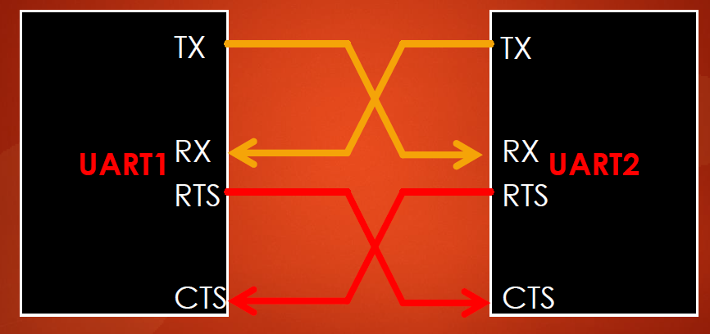
Universal ASYNCHRONOUS RECEIVER/ TRANSMITTER
It is an asynchronous serial communication protocol.
The components are a transmitter(TX), receiver(RX), baud rate generator and control registers
The baud rate must be agreed upon by both the TX and RX (e.g., 9600 bps, 115200 bps )
The TX of one device is connected to the RX of another device and vice versa.

Slide 19
The baud rate shows how fast the data is sent over a serial line. If you invert the baud rate you get how long it takes to transmit a single bit. This value determines how long the transmitter holds a serial line high or low.
The speed of UART is dependent on the bus speed of which the peripheral is attached to.

Slide 20
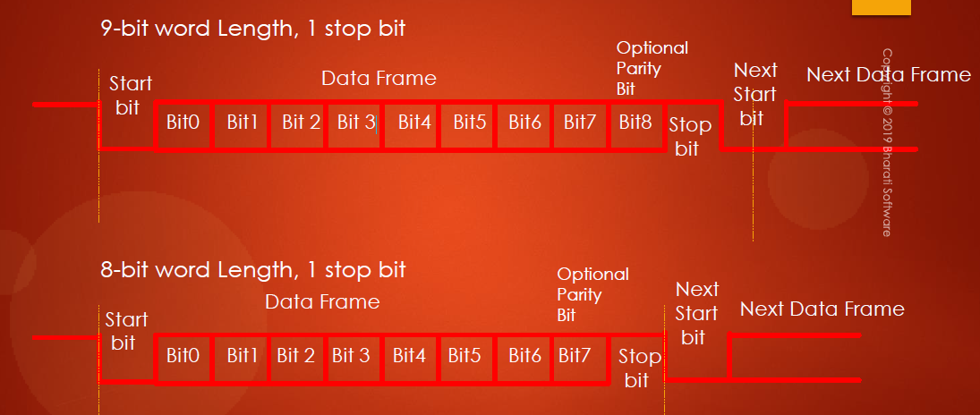
UART frame format is as shown:

Slide 21
Advantages of UART
Simple and widely used
No need for clock signal
Full- duplex communication
Disadvantages of UART
Limited distance and speed
Requires precise timing agreements
Not suitable for multiple devices on the same bus

Slide 22
HANDS ON SESSION
I2C Lab – Connecting an OLED display to Raspberry Pi Pico
SPI Lab - Writing to and reading data to an SD card
UART Lab – Transmitting and receiving data using HC-06 Bluetooth Module

Slide 23
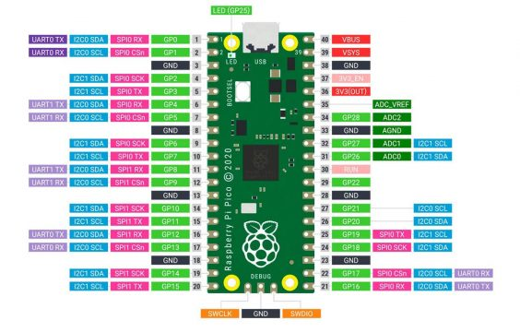

Slide 24
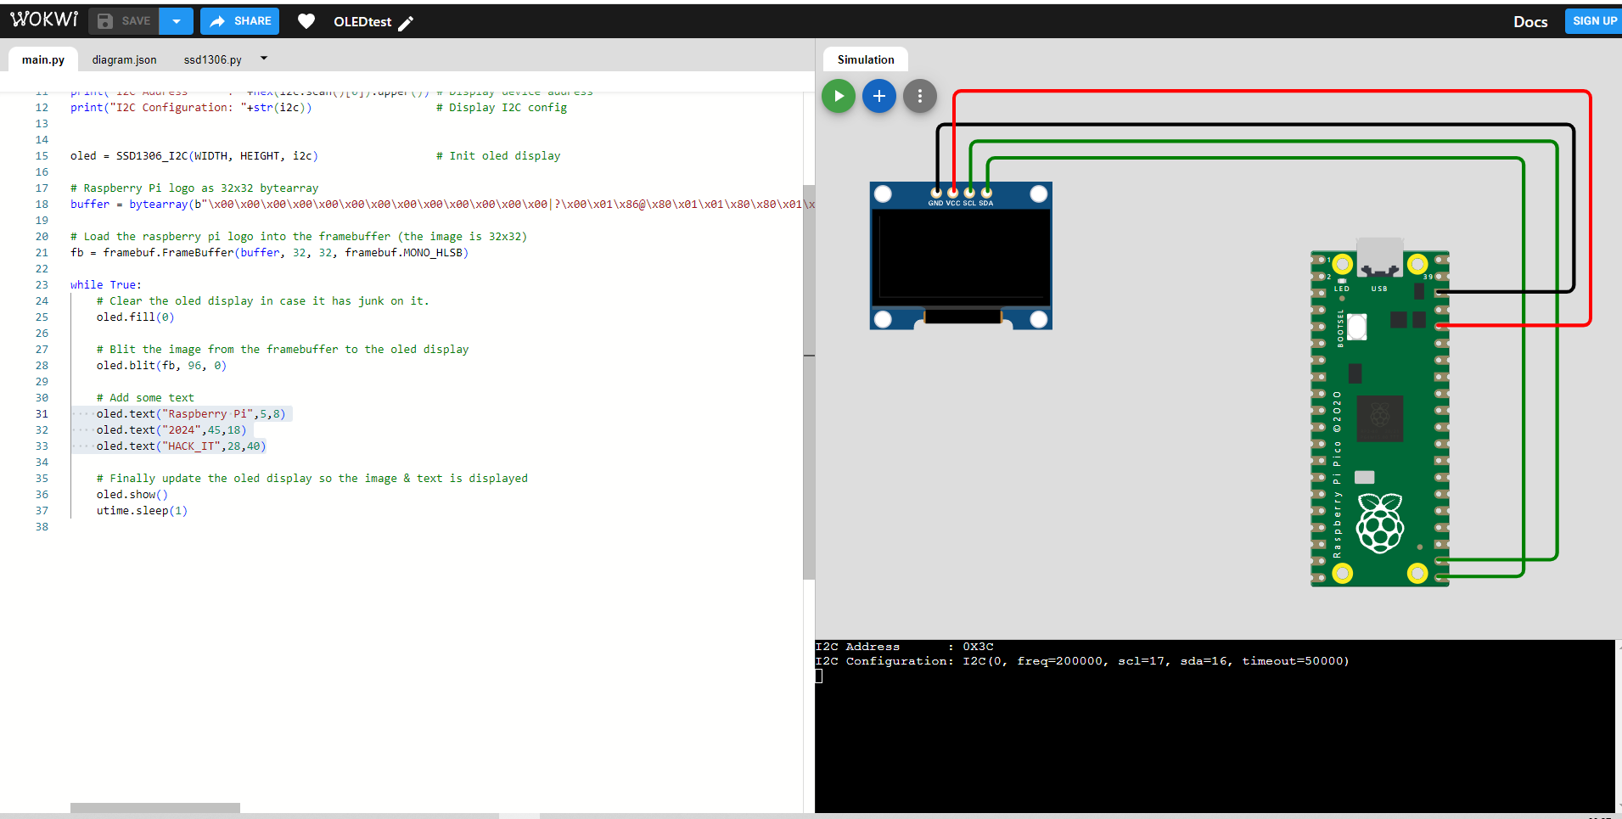

Slide 25
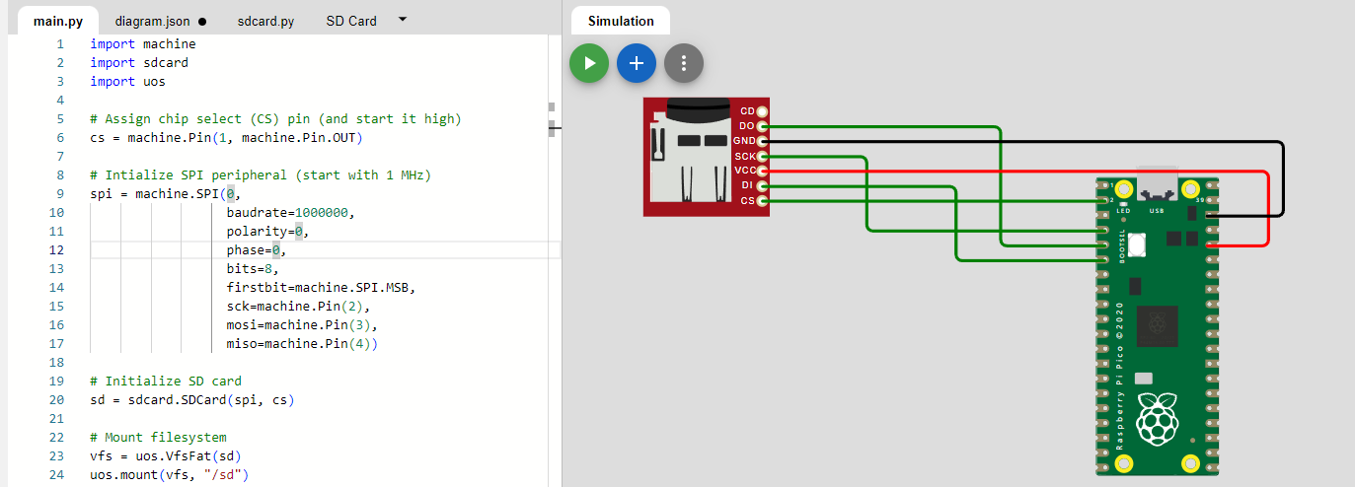

Slide 26
REFERENCES AND READS
Mastering Microcontroller with Embedded Driver Development by FastBit Embedded Brain Academy
https://docs.micropython.org/en/latest/library/index.html

Slide 27

Q/A

Slide 28
Socials
LinkedIn: Otieno Kennedy Odeyo
Email: kenodeyo@gmail.com
Contact: +254-793036309

